Slide 1
CRUD Operation
Using php

Slide 2
Topics
Server Connection
Migration
CRUD (Create, Read, Update, Delete)
File Upload
Encryption
Session

Slide 3
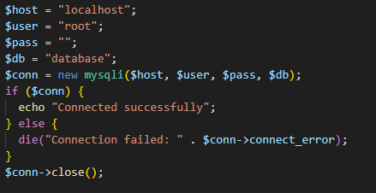
Server Connection
This is use to connect PHP app to server

Slide 4
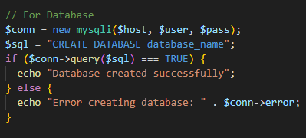
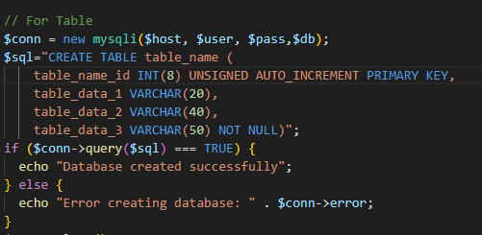
Migration
This is use to create database and table when we change server

Slide 5
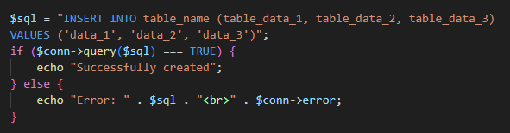
Create
It is use to CREATE/INSERT data into table

Slide 6
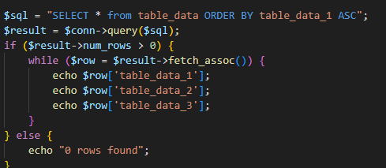
Read
It is use to READ data from table

Slide 7
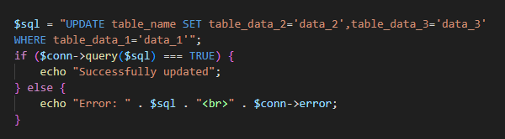
Update
It is use to UPDATE data from table

Slide 8
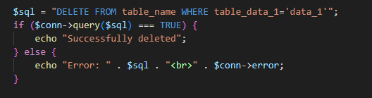
Delete
It is use to DELETE data from table

Slide 9
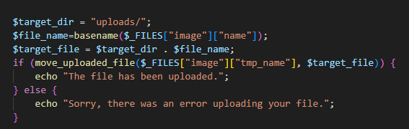
File Upload
It is use to Upload FILE

Slide 10
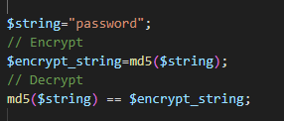
Encryption
It is use to Encryption our password or sensitive data.
In php we use md5() and it calculates hash of a string.

Slide 11
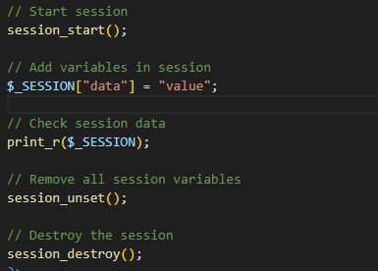
Session
A session is a way to store information (in variables) to be used across multiple pages.

